Slide 1
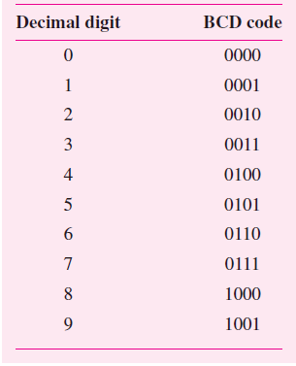
Binary-Coded-Decimal Representation
In digital systems it is possible to represent decimal numbers simply by encoding each digit in binary form. This is called the binary-coded-decimal (BCD) representation.
Because there are 10 digits to encode, it is necessary to use four bits per digit.
Each digit is encoded by the binary pattern that represents its unsigned value, as shown in Table.
Note that only 10 of the 16 available patterns are used in BCD, which means that the remaining 6 patterns should not occur in logic circuits that operate on BCD operands
these patterns are usually treated as don’t-care conditions in the design process.
BCD representation was used in some early computers as well as in many handheld calculators.
It provides a format that is convenient when numerical information is to be displayed on a simple digit-oriented display.
But it has drawbacks like complexity of circuits that perform arithmetic operations and the fact that six of the possible code patterns are wasted.

Slide 2
One digit BCD Addition
The addition of two BCD digits is complicated by the fact that the sum may exceed 9, in which case a correction will have to be made.
Let X = x₃x₂x₁x₀ and Y = y₃y₂y₁y₀ represent the two BCD digits and let S = s₃s₂s₁s₀ be the desired sum digit, S = X + Y .
If X + Y ≤ 9, then the addition is the same as the addition of 2 four-bit unsigned binary numbers.
But, if X + Y > 9, then the result requires two BCD digits.
Moreover, the four-bit sum obtained from the four-bit adder may be incorrect.
There are two cases where some correction has to be made:
when the sum is greater than 9 but no carry-out is generated using four bits, and
when the sum is greater than 15 so that a carry-out is generated using four bits.

Slide 3
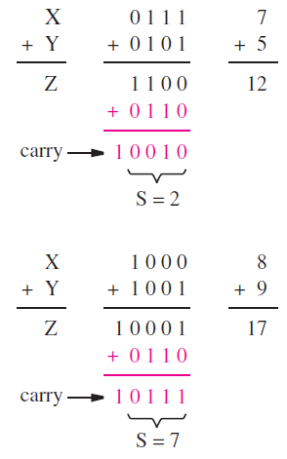
Contd.
In the first case the four-bit addition yields, an intermediate sum, Z = 7 + 5 = 12.
To obtain a correct BCD result, we must generate S = 2 and a carry-out of 1.
The necessary correction is apparent from the fact that the four-bit addition is a modulo-16 scheme, whereas decimal addition is a modulo-10 scheme.
Therefore, a correct decimal digit can be generated by adding 6 to the result of four-bit addition whenever this result exceeds 9.
Thus we can arrange the computation as follows
Z = X + Y
If Z ≤ 9, then S = Z and carry-out = 0
if Z > 9, then S = Z + 6 and carry-out = 1

Slide 4
Contd.
The second case of BCD addition is shown in Figure i.e. what happens when X + Y > 15.
In this case the four least-significant bits of Z represent the digit 1, which is wrong.
But a carry is generated, which corresponds to the value 16, that must be taken into account.
Again adding 6 to the intermediate sum Z provides the necessary correction.

Slide 5
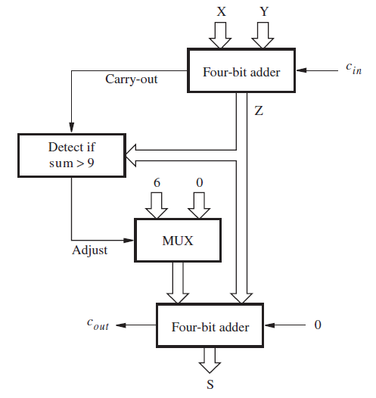
Block diagram for a one-digit BCD adder.
Figure gives a block diagram of a one-digit BCD adder.
The block that detects whether Z > 9 produces an output signal, Adjust, which controls the multiplexer that provides the correction when needed.
A second four-bit adder generates the corrected sum bits.
If Adjust = 0, then S = Z + 0; if Adjust = 1, then S = Z + 6 and carry-out = 1.

Slide 6
Contd.
Next we can derive the circuit to implement the block diagram.
Firstly, to define the Adjust function, we can observe that
the intermediate sum will exceed 9 if the carry-out from the four-bit adder is equal to 1, or if z₃ = 1 and either z₂ or z₁ (or both) are equal to 1.
Hence the logic expression for this function is
Adjust = Carry-out + z₃(z₂ + z₁)
Instead of implementing another complete four-bit adder to perform the correction, we can use a simpler circuit
because the addition of constant 6 does not require the full capability of a four-bit adder.
The least-significant bit of the sum, s₀, is not affected at all;
hence s₀ = z₀.
Bit s₃ is the same as z₃ if the carry-out from the two-bit adder is 0, and it is equal to complement of z₃ if this carry-out is equal to 1.
Hence, a two-bit adder may be used to develop bits s₂ and s₁.
Also, since whenever the adjustment of 6 is made there is a carry to the next digit position,
cout is just equal to the Adjust signal

Slide 7
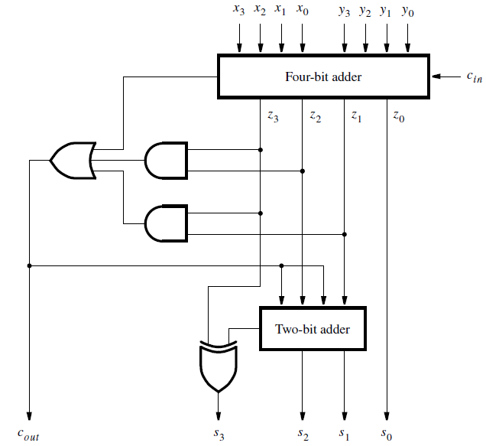
Circuit for a one-digit BCD adder
A complete circuit that implements the one-digit BCD addition is shown in Figure.
Using the one-digit BCD adder as a basic block, it is possible to build larger BCD adders in the same way as a binary full-adder is used to build larger ripple-carry binary adders.
Subtraction of BCD numbers can be handled with the radix-complement approach.
Just as we use 2’s complement representation to deal with negative binary numbers, we can use 10’s complement representation to deal with decimal numbers.

Slide 8
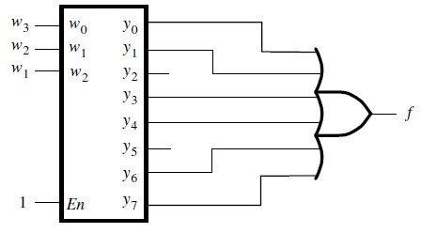
Problem: Implement the function f (w₁, w₂, w₃) = Σm(0, 1, 3, 4, 6, 7) by using a 3-to-8 binary decoder and an OR gate.
Solution : The decoder generates a separate output for each minterm of the required function.
These outputs are then combined in the OR gate, giving the circuit in Figure

Slide 9
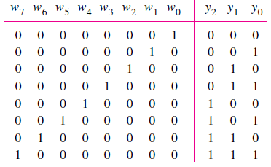

Problem: Derive a circuit that implements an 8-to-3 binary encoder.
The truth table for the encoder is shown in Figure. Only those rows for which a single input variable is equal to 1 are shown; the other rows can be treated as don’t care cases.
From the truth table it is seen that the desired circuit is defined by the equations,

Slide 10
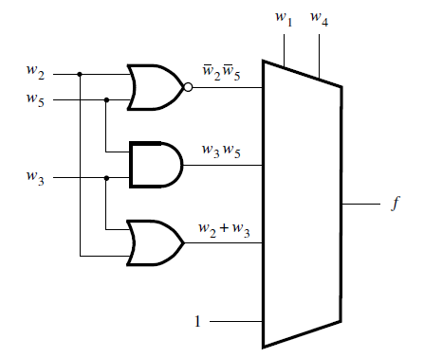

Problem: Implement the function by using a 4-to-1 multiplexer and as few other gates as possible. Assume that only the uncomplemented inputs w₁, w₂, w₃, w₄, and w₅ are present.
Solution: Since variables w₁ and w₄ appear in more product terms in the expression for f than the other three variables, let us perform Shannon’s expansion with respect to these two variables.
The expansion gives
We can implement the function as shown

Slide 11
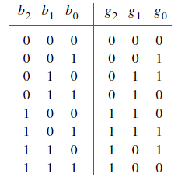
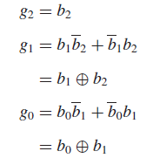
Problem: We have seen that the rows and columns of a Karnaugh map are labeled using Gray code. This is a code in which consecutive valuations differ in one variable only. Design a circuit that can convert a binary code into Gray code.
Truth table given depicts the conversion between three-bit binary and Gray codes.
From the truth table, it follows that

Slide 12
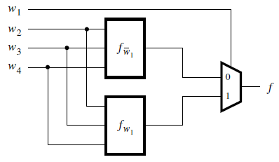
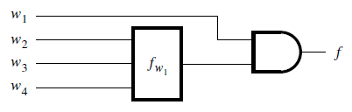
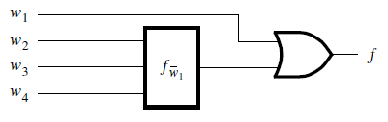
Problem : Any logic function can be decomposed using Shannon’s expansion theorem. For a four-variable function, f (w₁, . . . ,w₄), the expansion with respect to w₁ is
A circuit that implements this expression is given in Figure
(a) If the decomposition yields f_{w1}= 0, then the multiplexer in the figure can be replaced by a single logic gate.
(b) Repeat part (a) for the case where f_{w1}= 1.
Solution for part (a)
Solution for part (b)

Slide 13
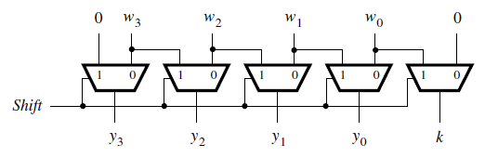
Problem: In digital systems it is often necessary to have circuits that can shift the bits of a vector by one or more bit positions to the left or right. Design a circuit that can shift a four-bit vector W = w₃w₂w₁w₀ one bit position to the right when a control signal Shift is equal to 1. Let the outputs of the circuit be a four-bit vector Y = y₃y₂y₁y₀ and a signal k, such that if Shift = 1 then y₃ = 0, y₂ = w₃, y₁ = w₂, y₀ = w₁, and k = w₀. If Shift = 0 then Y = W and k = 0.
The shifter circuit here shifts the bits of an input vector by one bit position to the right. It fills the vacated bit on the left side with 0.
The required circuit can be implemented with five 2-to-1 multiplexers as shown in Figure.
The Shift signal is used as the select input to each multiplexer.

Slide 14
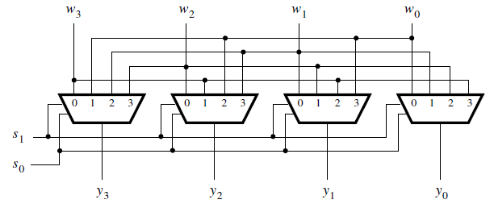
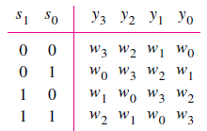
Problem: A versatile shifter circuit is able to shift by more bit positions at a time. If the bits that are shifted out are placed into the vacated positions on the left, then the circuit effectively rotates the bits of the input vector by a specified number of bit positions. Such a circuit is often called a barrel shifter. Design a four-bit barrel shifter that rotates the bits by 0, 1, 2, or 3 bit positions as determined by the valuation of two control signals s1 and s0.
Solution: The required action is given in truth table.
The barrel shifter can be implemented with four 4-to-1 multiplexers as shown in Figure. The control signals s1 and s0 are used as the select inputs to the multiplexers
A barrel shifter circuit

